Slide 1
WELCOME

Slide 2
SMART AUTOMATION USING MACHINE LEARNING ALGORITHMS AND NEURAL INTERFACE
Guided by,
Ms.Shabna. M
Asst. Prof
Dept. Of CSE
MGM college of engineering & pharmaceutical sciences
Valanchery
Presented By,
Akshay Sankar
Hafeed K
Minhaj Fasalu

Slide 3
CONTENTS
INTRODUCTION
OBJECTIVE
LITERATURE SURVEY
EXISTING SYSTEM
PROPOSED SYSTEM
SYSTEM ARCHITECTURE
DESIGN DIAGRAM
REQUIREMENTS
MODULES
EXPECTED OUTCOME
CONCLUSION
REFERENCES
11-05-2021

Slide 4
INTRODUCTION
Smart Home Systems are the subset of everyday computing.
When this application is controlled by machine intelligence to provide circumstance-aware settings.
Here we define an improved Home automation system using multiple machine learning algorithms

Slide 5
OBJECTIVE
To bring Strict Power Control and Save Energy
To Achieve an intelligent control system
To Bring Down the Manual Setting to Zero With Intelligent Control

Slide 6
LITERATURE SURVEY
NO | PAPER | ADVANTAGES | DISADVANTAGES
1 | Smart Energy Efficient Home Automation System Using IoT | Less Manual Control | Only Have A Web Based Control No Learning System
2 | i-learning IoT: An intelligent self learning system for home automation using IoT | Less Manual Control Learning System | Uses Less Accurate Learning Algorithm
3 | Enhanced Smart Home Automation System based on Internet of Things | Less Manual Control App Based System Can Controlled By Anywhere In The World | Not A Learning System Does Not Have Web Capability

Slide 7
LITERATURE SURVEY
NO | PAPERS | ADVANTAGES | DISADVANTAGES
4 | Enabling IoT automation using local clouds | Less Manual Control Wide range of IOT Device Capabilities APP AND WEB Based | Internet Is Requirement For Connecting More Device Inoperability
5 | Smart Automation using Machine Learning Algorithms | No Manual Control Required No App or Web Based Apps Required Complete Learning System Facial Recognition Internet Is Not A Mandatory | User Must Depend On Some Manual Control Until System Learns User Pattern

Slide 8
EXISTING SYSTEM
Traditional home automation systems that provide only remote access and control
They are not that effective in terms of being ‘smart’
Has Lot of Manual Control
Need an interface for operation
Not Efficient

Slide 9
PROPOSED SYSTEM – Emotion Recognition Mode
Proposed System Uses SVM (Support Vector Machine)Classifier
By using Supervised Learning, the algorithm will output a hyper plane which categorizes new examples.
To use SVM to recognize facial expression, we extract facial landmark key points first and then it is given to SVM classifier to detect user’s mood

Slide 10
PROPOSED SYSTEM – Emotion Recognition Mode
To detect the landmarks that are crucial points required for identifying the emotions/expressions, we use DLib library for python
Normalization of key-points is done by calculating the mean of x and y axes which gives us the coordinates for center of gravity in all facial landmarks.
DLib Library file help to identify eyes,lips,nose,etc attributes on face

Slide 11
PROPOSED SYSTEM – Neural Interface Mode
Proposed Mode Uses EEG(Electro Encephalograph)sensor to detect beta waves from brain
These waves are transmitted over Bluetooth or Wi-Fi to Our system for processing
According to wave pattern respective profiles are switched

Slide 12
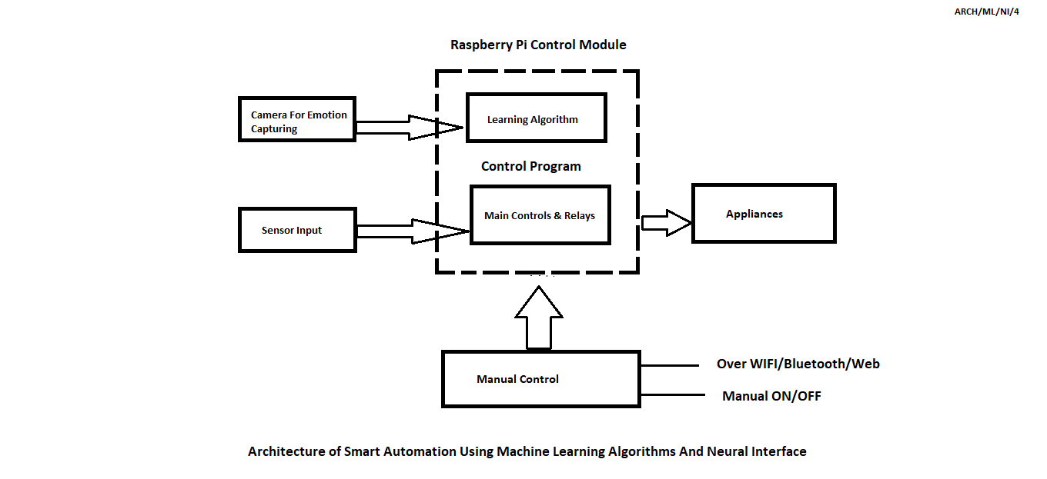
SYSTEM ARCHITECTURE

Slide 13
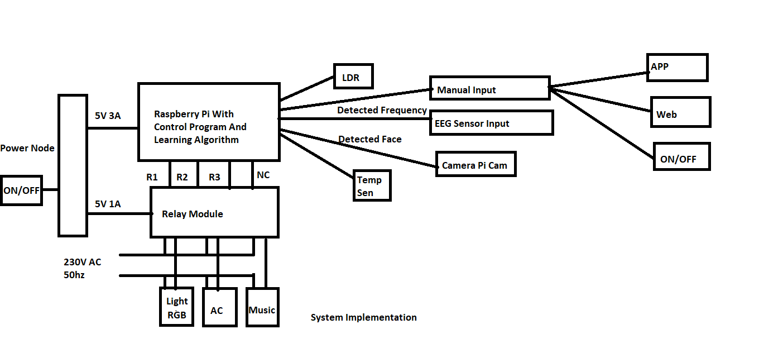
DESIGN DIAGRAM

Slide 14
REQUIREMENTS
Main Components Required
Raspberry Pi
Relay 5v||230v 10A x 4
PI Cam 720p
EEG Sensor,Temp sensor,LDR,Humidity Sensor,
Services Required
IFTTT
Blynk
Git

Slide 15
MODULE 1 – MANUAL MODE
Connected ESP8266 to Network Via WIFI Authentication
Controls relay via Blynk App through Blynk App
Relay Controls Connected Appliances
Expected Outcome :- Control 4CH Relay Manually through Blynk App

Slide 16
MODULE 2 – AUTOMATIC MODE
In Automatic mode system uses existing data's of user usage patterns and data from sensors to switch profiles
Voice commands can be used to control the system status

Slide 17
MODULE 3 – EMOTION RECOGNITION MODE
Connected Webcam is used to detect emotion
Face and facial landmarks are used to identify emotion
According to emotion profiles are switched
Each profile contain different tasks

Slide 18
MODULE 4 – NEURAL INTERFACE MODE
Uses EEG Sensor to Interface with Brain to Carry brain wave signals to raspberry
Modulation of waves carries different instruction to raspberry pi to perform different tasks
EEG sensor is tuned to detect beta waves which deals with consciousness
According to wave modulation profiles are switched

Slide 19
EXPECTED OUTCOME
Implement a Intelligent System That controls Usage of Electricity
Proposed System Brings Easiness & Comfort to Users
Bring Manual Control To Zero

Slide 20
CONCLUSION
In Next Stage complete integration of facial detection and profile switching will be added
Project Completion Rate :- 38%

Slide 21
REFERENCES
Minaee S, Abdolrashidi Minaee, Shervin, and Amirali Abdolrashidi. ”Deep-Emotion: Facial Expression Recognition Using Attentional Convolutional Network.” arXiv preprint arXiv:1902.01019 (2019).
Amarappa, S., and S. V. Sathyanarayana. “Data classification using Support vector Machine(SVM), a simplified approach.” Int. J. Electron. Comput. Sci. Eng 3 (2014): 435-445.
Van Gent Paul, “Emotion Recognition using Facial Landmarks, Python, DLib and OpenCV,” [Online]. Available:

Slide 22
THANK YOU

